Slide 1
Chapter - 1 Semiconductor Diodes
‹#›
Independent University Bangladesh (IUB)

Slide 2
Background
‹#›
Independent University Bangladesh (IUB)

Slide 3
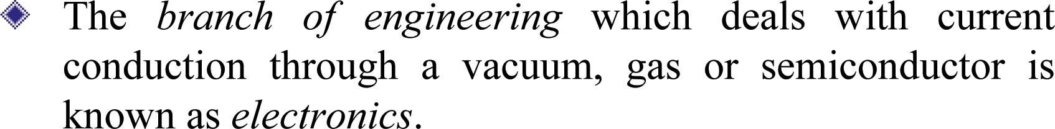
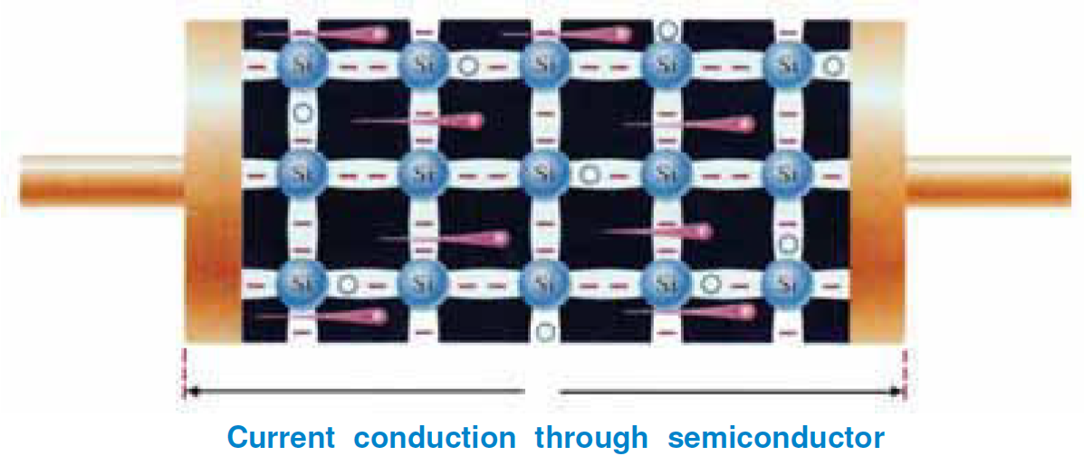
Electronics
‹#›
Independent University Bangladesh (IUB)

Slide 4
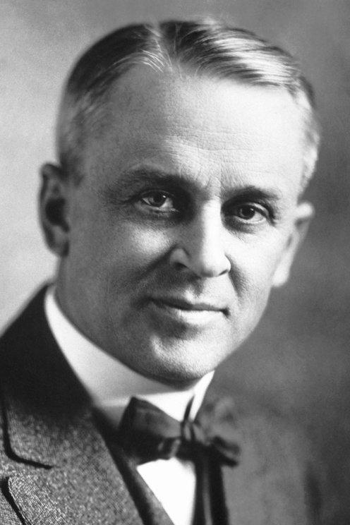
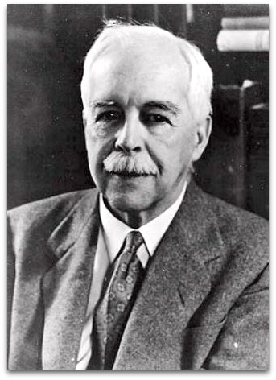
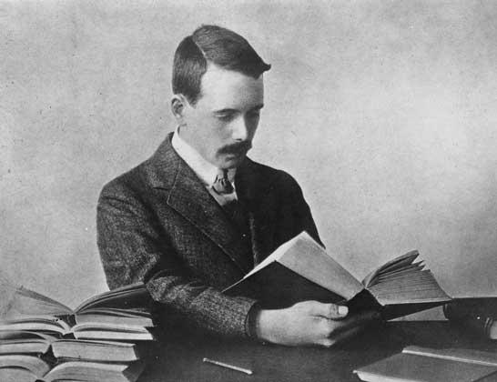
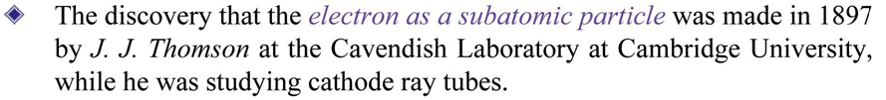
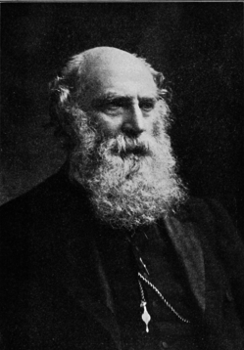
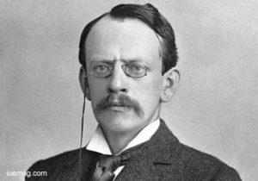
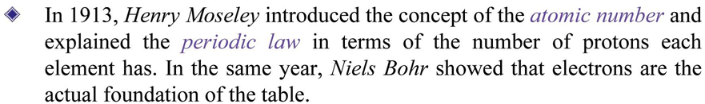
History of Electron
‹#›
Independent University Bangladesh (IUB)

Slide 5
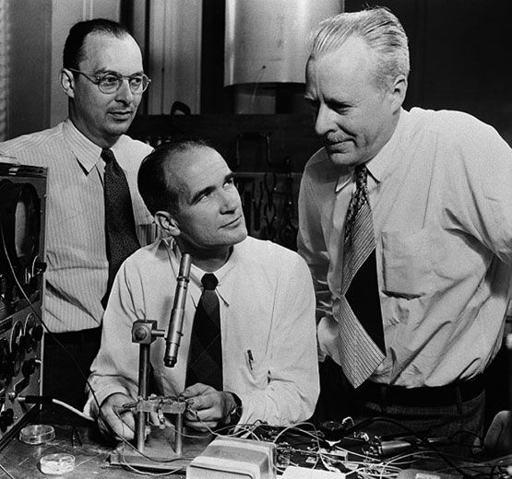
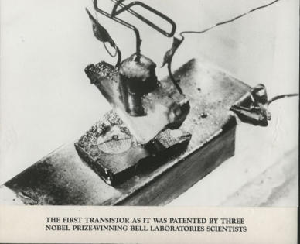
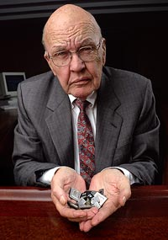
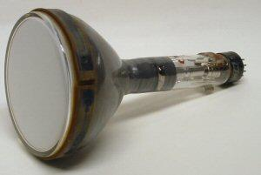
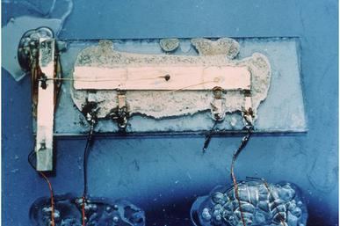
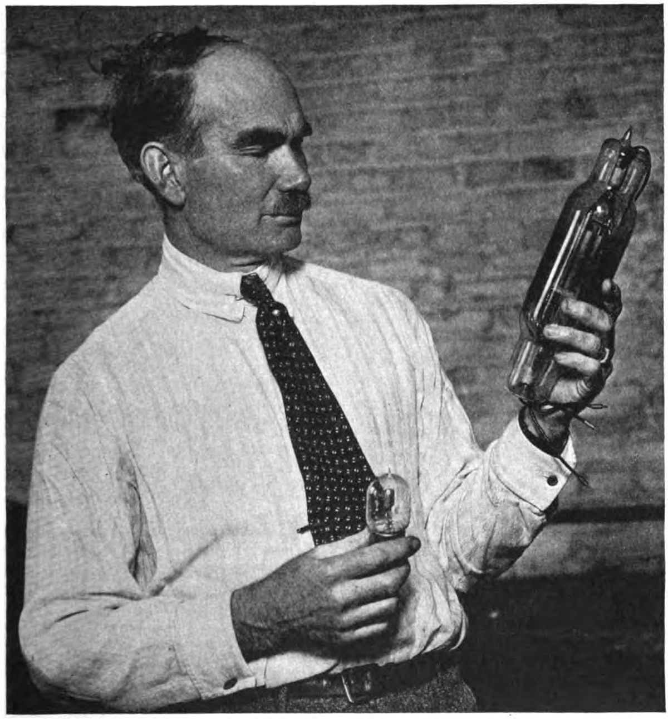
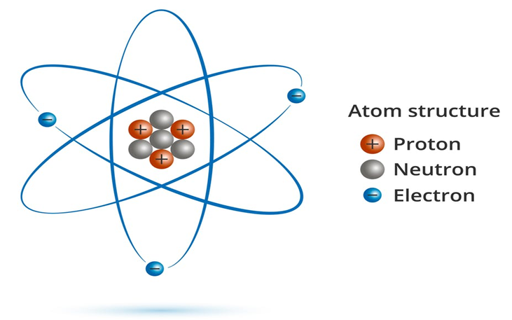
Timelines
‹#›
Independent University Bangladesh (IUB)

Slide 6
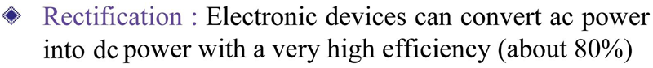
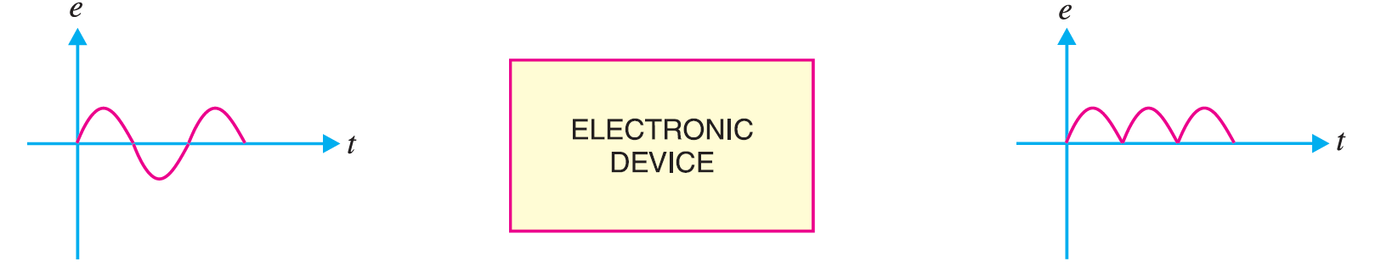
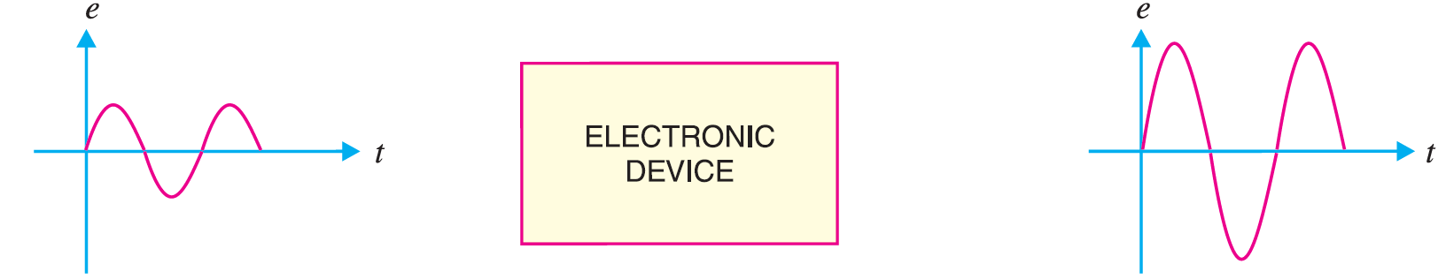
Applications
‹#›
Independent University Bangladesh (IUB)

Slide 7
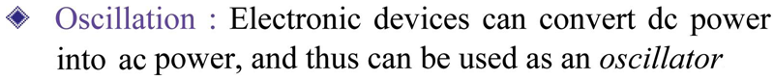
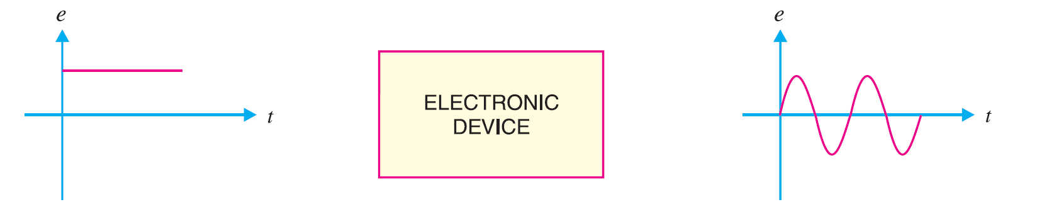
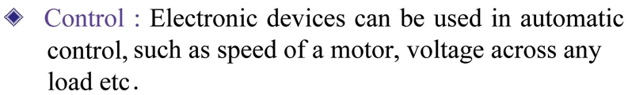
Applications
‹#›
Independent University Bangladesh (IUB)

Slide 8

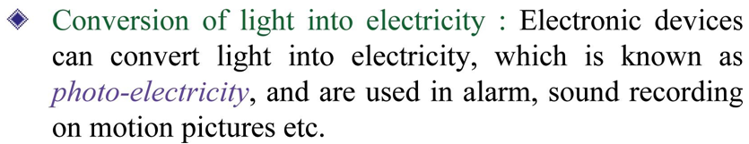
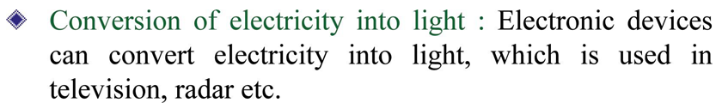
Applications
‹#›
Independent University Bangladesh (IUB)

Slide 9
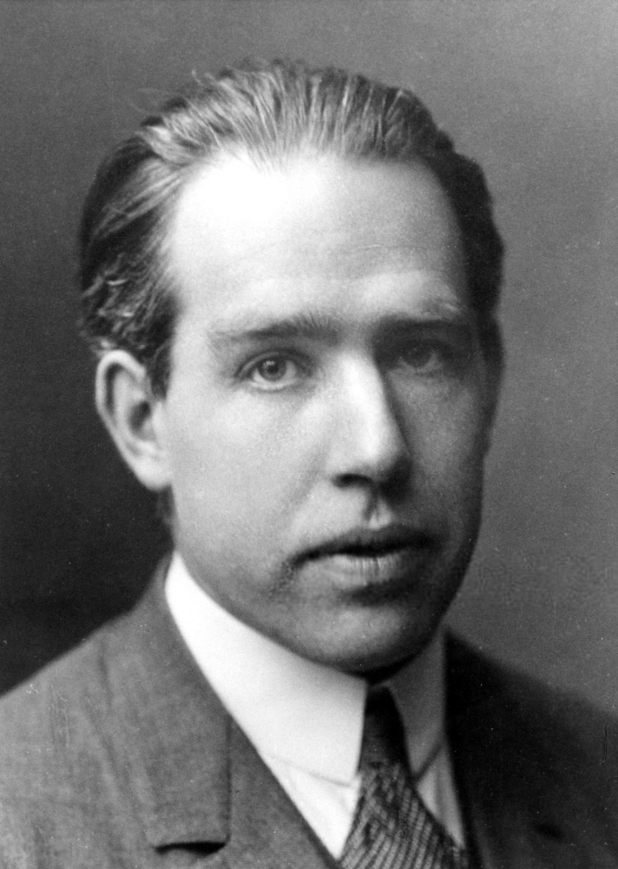
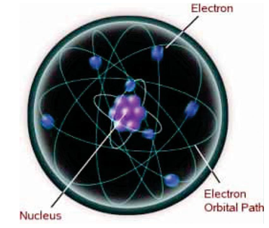

Atomic Structure
‹#›
Independent University Bangladesh (IUB)

Slide 10
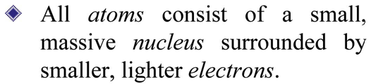
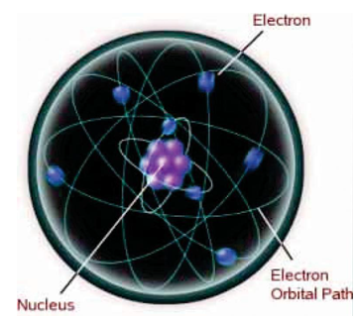
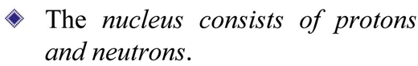
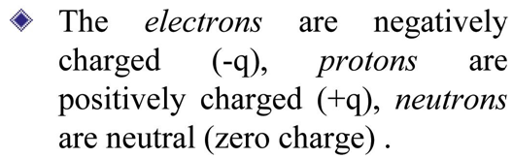
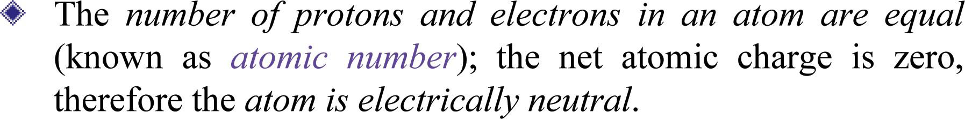
Atomic Structure
‹#›
Independent University Bangladesh (IUB)

Slide 11
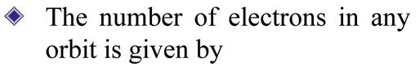
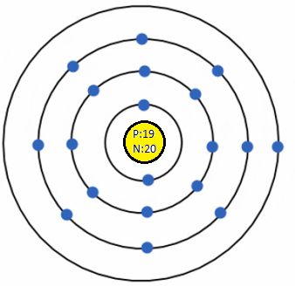
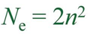
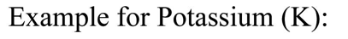
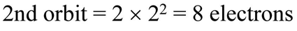
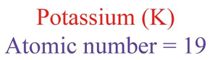
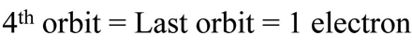
Structure of Elements
‹#›
Independent University Bangladesh (IUB)

Slide 12
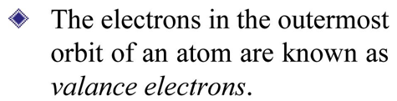
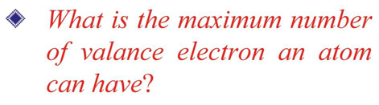
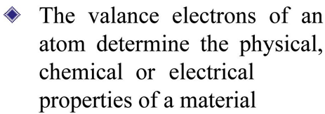
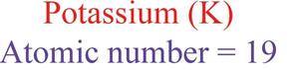
Valance Electrons
Valance Electron
‹#›
Independent University Bangladesh (IUB)

Slide 13
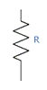
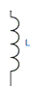
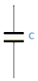
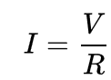
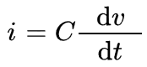
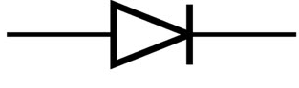
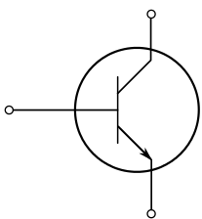
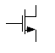

Basic Electronic Components
Basic Electrical components – R L C
Some Electronic components –
Circuit Theorem: KVL, KCL
Norton and Thevenin Equivalent
Ohm’s Law: For Capacitors:
Resistor
Inductor
Capacitor
Diode
Operation, Modeling &
Circuits
Bi-polar Transistor
MOS Transistor
Operational Amplifier
‹#›
Independent University Bangladesh (IUB)

Slide 14



Semiconductor Materials
Conductor:
The term conductor is applied to any material that will support a generous flow of charge when a voltage source of limited magnitude is applied across its terminals.
Insulator:
An insulator is a material that offers a very low level of conductivity under pressure from an applied voltage source.
Semiconductor:
A semiconductor, therefore, is a material that has a conductivity level somewhere between the extremes of an insulator and a conductor.
The three semiconductors used most frequently in the construction of electronic devices are:
Ge : Germanium
Si : Silicon
GaAs : Gallium arsenide
Resistivity
‹#›
Independent University Bangladesh (IUB)

Slide 15
Semiconductor Basics
‹#›
Independent University Bangladesh (IUB)

Slide 16



Semiconductor Materials
Conductor:
When the number of valence electrons of an atom is less than 4 (i.e. half of the maximum
eight electrons), the material is usually a metal and a conductor.
Insulator:
When the number of valence electrons of an atom is more than 4, the material is usually a
non-metal and an insulator.
Semiconductor:
When the number of valence electrons of an atom is 4 (i.e. exactly one-half of the maximum 8 electrons), the material has both metal and non-metal properties and is usually a semi-conductor.
‹#›
Independent University Bangladesh (IUB)

Slide 17


Covalent Bonding
Covalent bonding of the silicon atom.
Covalent Bonding
A bonding of atoms, strengthened by the sharing of electrons, is called covalent bonding.
The germanium atom has 32 orbiting electrons, while silicon has 14 orbiting electrons. In each case, there are 4 electrons in the outermost shell (aka valence shell). These four electrons in the outermost shell are referred to as valence electrons
In a pure germanium or silicon crystal these 4 valence electrons are bonded to 4 adjoining atoms. Both Ge and Si are referred to as tetravalent atoms because they each have four valence electrons.
‹#›
Independent University Bangladesh (IUB)

Slide 18


Covalent Bonding
‹#›
Independent University Bangladesh (IUB)

Slide 19
Free Electron
Although the covalent bond will result in a stronger bond between the valence electrons and their parent atom, it is still possible for the valence electrons to absorb sufficient kinetic energy from natural causes to break the covalent bond and assume the “free” state.
These natural causes include effects such as light energy in the form of photons and thermal energy from the surrounding medium. At room temperature there are approximately 1.5 X 10¹⁰ free carriers in a cubic centimeter of intrinsic silicon material.
‹#›
Independent University Bangladesh (IUB)

Slide 20

Intrinsic Material
Intrinsic materials are those semiconductors that have been carefully refined to reduce the impurities to a very low level —essentially as pure as can be made available through modern technology.
The free electrons in the material due only to natural causes are referred to as intrinsic carriers.
Germanium is a better conductor at room temperature. This may be true, but both are still considered poor conductors in the intrinsic state.
An increase in temperature of a semiconductor can result in a substantial increase in the number of free electrons in the material.
Semiconductor materials such as Ge and Si that show a reduction in resistance with increase in temperature are said to have a negative temperature coefficient.
‹#›
Independent University Bangladesh (IUB)

Slide 21


Energy Levels
In the isolated atomic structure there are discrete (individual) energy levels associated with each orbiting electron
Each material has its own set of permissible energy levels for the electrons in its atomic structure.
The more distant the electron from the nucleus, the higher the energy state, and any electron that has left its parent atom has a higher energy state than any electron in the atomic structure.
Ionization
Ionization is the mechanism whereby an electron can absorb sufficient energy to break away from the atomic structure and enter the conduction band. The energy associated with each electron is measured in electron volts (eV). W (energy)= QV eV
Q is the charge associated with a single electron in coulomb, and V is potential diff (V)
‹#›
Independent University Bangladesh (IUB)

Slide 22
Extrinsic Material - Doping
The characteristics of semiconductor materials can be altered significantly by the addition of certain impurity atoms into the relatively pure semiconductor material.
The process of adding impurity atoms into the relatively pure semiconductor material is called doping.
These impurities, although only added to perhaps 1 part in 10 million, can alter the energy band structure sufficiently to totally change the electrical properties of the material.
Extrinsic material
A semiconductor material that has been subjected to the doping process is called an extrinsic material.
There are two extrinsic materials of immeasurable importance to semiconductor device fabrication:
n-type material
p-type material
‹#›
Independent University Bangladesh (IUB)

Slide 23


n-Type Material
The n-type is created by introducing those impurity elements that have five valence electrons (pentavalent), such as antimony, arsenic, and phosphorus.
Four covalent bonds are still present.
There is, however, an additional fifth electron due to the impurity atom, which is unassociated with any particular covalent bond.
This remaining electron, loosely bound to its parent (antimony) atom, is relatively free to move within the newly formed n-type material.
Since the inserted impurity atom has donated a relatively “free” electron to the structure: “Diffused impurities with five valence electrons are called donor atoms.”
It is important to realize that even though a large number of “free” carriers have been established in the n-type material, it is still electrically neutral since ideally the number of positively charged protons in the nuclei is still equal to the number of “free” and orbiting negatively charged electrons in the structure.
‹#›
Independent University Bangladesh (IUB)

Slide 24

n-Type Material
A discrete energy level (called the donor level) appears in the forbidden band with an E_{g} significantly less than that of the intrinsic material.
Those “free” electrons due to the added impurity sit at this energy level and have less difficulty absorbing a sufficient measure of thermal energy to move into the conduction band at room temperature.
At room temperature in an intrinsic Si material there is about one free electron for every 10¹² atoms.
If the doping level is 1 in 10 million (10⁷), the ratio (10¹²/10⁷ =10⁵) would indicate that the carrier concentration has increased by a ratio of 100,000 : 1.
‹#›
Independent University Bangladesh (IUB)

Slide 25


p-Type Material
The p-type material is formed by doping a pure germanium or silicon crystal with impurity atoms having three valence electrons.
The elements most frequently used for this purpose are boron, gallium, and indium.
There is now an insufficient number of electrons to complete the covalent bonds of the newly formed lattice.
The resulting vacancy is called a hole and is represented by a small circle or positive sign due to the absence of a negative charge.
Since the resulting vacancy will readily accept a “free” electron: “The diffused impurities with three valence electrons are called acceptor atoms.”
The resulting p-type material is electrically neutral, for the same reasons described for the n-type material.
‹#›
Independent University Bangladesh (IUB)

Slide 26


Majority and Minority Carriers
In the intrinsic state, the number of free electrons in Ge or Si is due only to those few electrons in the valence band that have acquired sufficient energy from thermal or light sources to break the covalent bond or to the few impurities that could not be removed.
The vacancies left behind in the covalent bonding structure represent the very limited supply of holes.
In an n-type material, the number of holes has not changed significantly from this intrinsic level.
As a result of that the number of electrons far outweighs the number of holes.
In an n-type material the electron is called the majority carrier and the hole the minority carrier.
For the p-type material the number of holes far outweighs the number of electrons
In a p-type material the hole is the majority carrier and the electron is the minority carrier.
When the fifth electron of a donor atom leaves the parent atom, the atom remaining acquires a net positive charge: hence the positive sign in the donor-ion representation.
For similar reasons, the negative sign appears in the acceptor ion.
‹#›
Independent University Bangladesh (IUB)

Slide 27
Semiconductor Diode
‹#›
Independent University Bangladesh (IUB)

Slide 28

Electron versus Hole Flow
If a valence electron acquires sufficient kinetic energy to break its covalent bond and fills the void created by a hole, then a vacancy, or hole, will be created in the covalent bond that released the electron.
Therefore, a transfer of holes to the left and electrons to the right, as shown in the Figure.
Conventional flow
Conventional flow is indicated by the direction of hole flow.
‹#›
Independent University Bangladesh (IUB)

Slide 29


n-type versus p-type
n-type materials make the Silicon (or Germanium) atoms more negative.
p-type materials make the Silicon (or Germanium) atoms more positive.
Join n-type and p-type doped Silicon (or Germanium) to form a p-n junction
The semiconductor diode is created by simply joining an n -type and a p-type material together: that means joining of one material with a majority carrier of electrons to one with a majority carrier of holes. .
‹#›
Independent University Bangladesh (IUB)

Slide 30
p-n junction
When the materials are joined, the negatively charged atoms of the n-type doped side are attracted to the positively charged atoms of the p-type doped side.
The electrons in the n-type material migrate across the junction to the p-type material (electron flow).
Or you could say the ‘holes’ in the p-type material migrate across the junction to the n-type material (conventional current flow). Resulting in a lack of free carriers in the region near the junction called depletion region
Only particles in this region are the positive and the negative ions: once the free carriers have been absorbed.
This region of uncovered positive and negative ions is called the depletion region due to the “depletion” of free carriers in the region.
p
n
depletion region
‹#›
Independent University Bangladesh (IUB)

Slide 31



Operating Conditions
• No Bias ( )
• Reverse Bias ( )
• Forward Bias ( )
The term bias refers to the application of an external voltage across the two terminals of the device to extract a response
‹#›
Independent University Bangladesh (IUB)

Slide 32



No Bias Condition
No external voltage is applied: V_{D} = 0V and no current is flowing I_{D} = 0A.
Only a modest depletion layer exists.
‹#›
Independent University Bangladesh (IUB)

Slide 33
No Bias Condition
No external voltage is applied: V_{D} = 0V and no current is flowing I_{D} = 0A
It is simply a diode with two leads sitting isolated on a laboratory bench
Under no-bias conditions, any minority carriers (holes) in the n -type material that find themselves within the depletion region for any reason whatsoever will pass quickly into the p -type material
The majority carriers (electrons) of the n -type material must overcome the attractive forces of the layer of positive ions in the n -type material and the shield of negative ions in the p -type material to migrate into the area beyond the depletion region of the p -type material
The number of majority carriers is so large in the n -type material that there will invariably be a small number of majority carriers with sufficient kinetic energy to pass through the depletion region into the p -type material
The same type of discussion can be applied to p -type material
The relative magnitudes of the flow vectors are such that the net flow in either direction is zero
Only a modest depletion layer exists.
‹#›
Independent University Bangladesh (IUB)

Slide 34



Reverse Bias Condition
External voltage is applied across the p-n junction in the opposite polarity of the p- and n-type materials.
This causes the depletion layer to widen.
The electrons in the n-type material are attracted towards the positive terminal and the ‘holes’ in the p-type material are attracted towards the negative terminal.
‹#›
Independent University Bangladesh (IUB)

Slide 35
Reverse Bias Condition
External voltage is applied across the p-n junction in the opposite polarity of the p- and n-type materials.
The number of positive ions in the depletion region of the n -type material will increase due to the large number of free electron drawn to the positive potential of the applied voltage
Similar reasons, the number of negative ions will increase in the p -type material
The net effect, therefore, is a widening of the depletion region
This widening of the depletion region will establish too great a barrier for the majority carriers to overcome, effectively reducing the majority carrier flow to zero
The minority carriers, however, will keep flowing
The current that exists under reverse-bias conditions is called the reverse saturation current and is represented by I_{s} .
‹#›
Independent University Bangladesh (IUB)

Slide 36


Forward Bias Condition
External voltage is applied across the p-n junction in the same polarity of the p- and n-type materials.
The depletion layer is narrow. The electrons from the n-type material and ‘holes’ from the p-type material have sufficient energy to cross the junction.
‹#›
Independent University Bangladesh (IUB)

Slide 37
Forward Bias Condition
External voltage is applied across the p-n junction in the same polarity of the p- and n-type materials.
The application of a forward-bias potential V_{D} will “pressure” electrons in the n –type material and holes in the p -type material to recombine with the ions near the boundary and reduce the width of the depletion region
The resulting minority-carrier flow of electrons from the p -type material to the n -type material has not changed in magnitude
The reduction in the width of the depletion region will result in a heavy majority-carrier flow across the junction
As the applied bias increases in magnitude, the depletion region will continue to decrease in width, resulting in an exponential rise in current
‹#›
Independent University Bangladesh (IUB)

Slide 38



Actual Diode Characteristics
Shockley’s equation, for the forward- and reverse-bias regions:
where,
I_{s} is the reverse saturation current
V_{D} is the forward-bias voltage
n is ideality factor, ranges between 1 and 2 (n=1 will be assumed in this course unless otherwise noted)
V_{T} is thermal voltage
where,
k is Boltzmann’s constant =1.38 X10⁻²³ J/K
T_{K} is the absolute temperature in kelvins
=273 + the temperature in °C
q is the magnitude of electronic charge
1.6 X 10⁻¹⁹ C
‹#›
Independent University Bangladesh (IUB)

Slide 39



Actual Diode Characteristics
Shockley’s equation, for the forward- and reverse-bias regions:
For V_{D} = 0 (No Bias)
For V_{D} < 0 (Reverse Bias)
For negative values of V_{D} the exponential term drops very quickly below the level of I and the resulting equation for I_{D} is simply
For V_{D} > 0 (Forward Bias)
For positive values of V_{D} the first term of the Shockley’s equation will grow very quickly and totally overpower the effect of the second term
‹#›
Independent University Bangladesh (IUB)

Slide 40
Deviation of Commercially Available Diodes
Theoretically, with all things perfect, the characteristics of a silicon diode should appear as shown by the dashed line
However, commercially available silicon diodes deviate from the ideal for a variety of reasons
Including the internal “body” resistance and the external “contact” resistance of a diode.
Both contributes to an additional voltage at the same current level
Also the actual reverse saturation current of a commercially available diode will normally be measurably larger than that appearing as the reverse saturation current in Shockley’s equation. Due to wide range of factors:
– leakage currents
– generation of carriers in the depletion region
– higher doping levels
– sensitivity to the intrinsic level of carriers
– a direct relationship with the junction area
– temperature sensitivity
‹#›
Independent University Bangladesh (IUB)

Slide 41

Breakdown Region
The diode is in the reverse bias condition.
At some point the application of too negative a voltage with the reverse polarity will result in a sharp change in the characteristics
The current increases at a very rapid rate in a direction opposite to that of the positive voltage region
Voltage across the diode increases in the reverse-bias region, the velocity of the minority carriers responsible for the reverse saturation current I_{s} also increases
Breakdown potential
Eventually, their velocity and associated kinetic energy will be sufficient to release additional carriers through collisions with otherwise stable atomic structures
These additional carriers can then aid the ionization process to the point where a high avalanche current is established and the avalanche breakdown region determined.
‹#›
Independent University Bangladesh (IUB)

Slide 42
Zener Breakdown / Zener Region
The avalanche region (V_{BV}) can be brought closer to the vertical axis by increasing the doping levels in the p - and n -type materials.
However, as V_{BV} decreases to very low levels, such as 5 V, another mechanism, called Zener breakdown , will contribute to the sharp change in the characteristic
It occurs because there is a strong electric field in the region of the junction that can disrupt the bonding forces within the atom and “generate” carriers.
Breakdown potential
Although the Zener breakdown mechanism is a significant contributor only at lower levels of V_{BV}, this sharp change in the characteristic at any level is called the Zener region
The maximum reverse-bias potential that can be applied before entering the breakdown region is called the peak inverse voltage (referred to simply as the PIV rating) or the peak reverse voltage (denoted the PRV rating)
‹#›
Independent University Bangladesh (IUB)

Slide 43

Knee and Breakdown Voltage
The point at which the diode changes from No Bias condition to Forward Bias condition happens when the electron and ‘holes’ are given sufficient energy to cross the p-n junction. This energy comes from the external voltage applied across the diode.
The Forward bias voltage required is called knee voltage (V_{K})
Ge diode V_{K} ≅ 0.3V
Si diode V_{K} ≅ 0.7V
GaAs diode V_{K} ≅ 1.2V
The relative magnitudes of the reverse breakdown voltages for each material
GaAs typically has maximum breakdown levels that exceed those of Si devices of the same power level by about 10%, with both having breakdown voltages that typically extend between 50 V and 1 kV
Ge typically has breakdown voltages of less than 100 V
‹#›
Independent University Bangladesh (IUB)

Slide 44

Temperature Effects
As temperature increases it adds energy to the diode.
It reduces the required Forward bias voltage in Forward Bias condition.
In the forward-bias region the characteristics of a silicon diode shift to the left at a rate of 2.5 mV per centigrade degree increase in temperature.
It increases the amount of Reverse current in Reverse Bias condition.
In the reverse-bias region the reverse current of a silicon diode doubles for every 10°C rise in temperature.
Increase of temperature increases maximum Reverse Bias Avalanche Voltage.
Germanium diodes are more sensitive to temperature variations than Silicon Diodes.
‹#›
Independent University Bangladesh (IUB)

Slide 45

Ideal vs. Practical Diode
p – n junction permits a generous flow of charge when forward-biased and a very small level of current when reverse-biased.
An analogy often used to describe the behavior of a semiconductor diode is a mechanical switch.
In forward-bias the diode acts like a closed switch permitting a generous flow of charge in the forward bias direction
In reverse-bias the level of current is so small in most cases that it can be approximated as 0 A and represented by an open switch
The semiconductor diode behaves in a manner similar to a mechanical switch in that it
can control whether current will flow between its two terminals.
Please note that:
The semiconductor diode is different from a mechanical switch in the sense that when
the switch is closed it will only permit current to flow in one direction
‹#›
Independent University Bangladesh (IUB)

Slide 46



Ideal vs. Practical Diode Characteristics
Ideally, if the semiconductor diode is to behave like a closed switch in the forward-bias region, the resistance of the diode should be 0Ω .
In the reverse-bias region its resistance should be ∞Ω to represent the open-circuit equivalent
First impressions might suggest that the commercial unit is a poor impression of the ideal switch
However when one considers that the only major difference is that the commercial diode rises at a level of 0.7 V rather than 0 V, there are a number of similarities between the two plots
At any current level on the vertical line, the voltage across the ideal diode is 0 V and the resistance is 0 .
Because the current is 0 mA anywhere on the horizontal line, the resistance is considered to be infinite ohms (an open-circuit) at any point on the axis.
‹#›
Independent University Bangladesh (IUB)

Slide 47
Similarities between Ideal and Practical Diode
Due to the shape and the location of the curve for the commercial unit in the forward-bias region there will be a resistance associated with the diode that is greater than 0 .
However, if that resistance is small enough compared to other resistors of the network in series with the diode, it is often a good approximation to simply assume the resistance of the commercial unit is 0 .
In the reverse-bias region, if we assume the reverse saturation current is so small it can be approximated as 0 mA, we have the same open-circuit equivalence provided by the open switch.
The result, therefore, is that there are sufficient similarities between the ideal switch and the semiconductor diode to make it an effective electronic device.
‹#›
Independent University Bangladesh (IUB)

Slide 48
Resistance Levels
As the operating point of a diode moves from one region to another the resistance of the diode will also change due to the nonlinear shape of the characteristic curve.
Semiconductors act differently to DC and AC currents. There are 3 types of resistances. • DC or Static Resistance • AC or Dynamic Resistance • Average AC Resistance
‹#›
Independent University Bangladesh (IUB)

Slide 49


DC or Static Resistance
[Formula 1.4]
For a specific applied DC voltage V_{D}, the diode will have a specific current I_{D}, and a specific resistance R_{D}. The amount of resistance R_{D}, depends on the applied DC voltage.
The higher the current through a diode, the lower is the dc resistance level.
‹#›
Independent University Bangladesh (IUB)

Slide 50



AC or Dynamic Resistance
If a sinusoidal rather than a dc input is applied, the situation will change completely.
The varying input will move the instantaneous operating point up and down a region of the characteristics and thus defines a specific change in current and voltage
With no applied varying signal, the point of operation would be the Q -point, determined by the applied dc levels.
The designation Q-point is derived from the word quiescent, which means “still or unvarying.”
A straight line drawn tangent to the curve through the Q -point will define a particular change in voltage and current that can be used to determine the ac or dynamic resistance for this region of the diode characteristics
[Formula 1.5]
Where Δ signifies a finite change in the quantity.
The lower the Q-point of operation (smaller current or lower voltage), the higher is the ac resistance.
‹#›
Independent University Bangladesh (IUB)

Slide 51







AC or Dynamic Resistance
The derivative of a function at a point is equal to the slope of the tangent line drawn at that point
Flipping the result,
Substituting n =1 and V_{T} = 26 mV;
[Formula 1.6]
The dynamic resistance can be found simply by substituting the quiescent value of the diode current into the equation.
This equation is accurate only for values of I_{D} in the vertical-rise section of the curve
For lesser values of I_{D} , n=2 (silicon) and the value of r_{d} obtained must be multiplied by a factor of 2.
For small values of I_{D} below the knee of the curve, this equation becomes inappropriate.
‹#›
Independent University Bangladesh (IUB)

Slide 52


AC or Dynamic Resistance
All the resistance levels determined thus far have been defined by the p – n junction and do not include the resistance of the semiconductor material itself (body resistance) and the resistance introduced by the connection between the semiconductor material and the external metallic conductor (contact resistance)
Adding a resistance denoted r_{B} :
Forward Bias region:
• r_{B} ranges from a typical 0.1Ω for high power devices to 2Ω for low power, general purpose diodes. In some cases r_{B} can be ignored. Reverse Bias region: The resistance is essentially infinite. The diode acts like an open circuit.
[Formula 1.7]
‹#›
Independent University Bangladesh (IUB)

Slide 53


Average AC Resistance
If the input signal is sufficiently large to produce a broad swing the resistance associated with the device for this region is called the average ac resistance.
The average ac resistance is, by definition, the resistance determined by a straight line drawn between the two intersections established by the maximum and minimum values of input voltage
[Formula 1.8]
AC resistance can be determined by picking 2 points on the characteristic curve developed for a particular circuit.
‹#›
Independent University Bangladesh (IUB)

Slide 54

Summary of Resistance Levels
‹#›
Independent University Bangladesh (IUB)

Slide 55
Diode Equivalent Circuits
An equivalent circuit is a combination of elements properly chosen to best represent the
actual terminal characteristics of a device or system in a particular operating region
Once the equivalent circuit is defined, the device symbol can be removed from a schematic and the equivalent circuit inserted in its place without severely affecting the actual behavior of the system.
The result is often a network that can be solved using traditional circuit analysis techniques.
Three diode equivalent circuits:
Piecewise-Linear Equivalent Circuit
Simplified Equivalent Circuit
Ideal Equivalent Circuit
‹#›
Independent University Bangladesh (IUB)

Slide 56



Piecewise-Linear Equivalent Circuit
One technique for obtaining an equivalent circuit for a diode is to approximate the characteristics of the device by straight-line segments
The resulting equivalent circuit is called a piecewise-linear equivalent circuit.
The straight-line segments do not result in an exact duplication of the actual characteristics, especially in the knee region
However, the resulting segments are sufficiently close to the actual curve to establish an equivalent circuit that will provide an excellent first approximation to the actual behavior of the device
The sloping section of the equivalence the average ac resistance r_{av}
r_{av} defines the resistance level of the device when it is in the “on” state.
The ideal diode is included to establish that there is only one direction of conduction through the device, and a reverse-bias condition will result in the open-circuit state for the device.
Since a silicon semiconductor diode does not reach the conduction state until V_{D} reaches 0.7 V with a forward bias, a battery V_{K} opposing the conduction direction must appear in the equivalent circuit
‹#›
Independent University Bangladesh (IUB)

Slide 57

Simplified Equivalent Circuit
For most applications, the resistance r_{av} is sufficiently small to be ignored in comparison to the other elements of the network
This approximation is frequently employed in semiconductor circuit analysis
The reduced equivalent circuit shows that a forward biased silicon diode in an electronic system under dc conditions has a drop of 0.7 V across it in the conduction state at any level of diode current
‹#›
Independent University Bangladesh (IUB)

Slide 58

Ideal Equivalent Circuit
We can take the analysis a step further and establish that a 0.7V level can often be ignored in comparison to the applied voltage level.
In this case the equivalent circuit will be reduced to that of an ideal diode
‹#›
Independent University Bangladesh (IUB)

Slide 59

Summary of Diode Equivalent Circuits
‹#›
Independent University Bangladesh (IUB)

Slide 60


Transition and Diffusion Capacitance
Basic equation for the capacitance of a parallel-plate capacitor is defined by:
Where ε is the permittivity of the dielectric (insulator) between the plates of area A
separated by a distance d
Capacitance in Reversed-Bias - Transition Capacitance
In a diode the depletion region (free of carriers) behaves essentially like an insulator between the layers of opposite charge. Since the depletion width ( d ) will increase with increased reverse-bias potential, the resulting transition capacitance will decrease
[Formula 1.9]
Where,
C (0) is the capacitance under no-bias conditions
V_{R} is the applied reverse bias potential
n is 1⁄2 or 1⁄3 depending on the manufacturing process for the diode
‹#›
Independent University Bangladesh (IUB)

Slide 61



Transition and Diffusion Capacitance
Capacitance in Forward-Bias - Diffusion Capacitance
Although the effect transition capacitance will also be present in the forward-bias region, it is overshadowed by a capacitance effect directly dependent on the rate at which charge is injected into the regions just outside the depletion region
The result is that increased levels of current will result in increased levels of diffusion capacitance
where τ_{T} is the minority carrier lifetime—the time is world take for a minority carrier such as a hole to recombine with an electron in the n -type material
[Formula 1.10]
‹#›
Independent University Bangladesh (IUB)

Slide 62

Reverse Recovery Time
Reverse Recovery Time t_{rr} is the amount of time it takes for the diode to stop conducting once the diode is switched from Forward Bias to Reverse Bias.
In the forward-bias state a large number of electrons from the n -type material progressing through the p -type material and a large number of holes in the n -type material
This creates a large number of minority carriers in each material
If the applied voltage is reversed to establish a reverse-bias situation, because of the large number of minority carriers in each material, the diode current simply reverses and stay at this measurable level for the period of time t_{s} (storage time) required for the minority carriers to return to their majority-carrier state in the opposite material
Eventually, when this storage phase has passed, the current will be reduced in level to that associated with the non-conduction state. This second period of time is denoted by t_{t} (transition interval)
t_{rr} = t_{s} + t_{t}
‹#›
Independent University Bangladesh (IUB)
transition interval
storage time

Slide 63
Reverse Recovery Time
Reverse Recovery Time is an important consideration in high-speed switching applications.
Most commercially available switching diodes have a t_{rr} in the range of a few nanoseconds to 1 ms.
Units are available, however, with a t_{rr} of only a few hundred picoseconds (10⁻¹² s)
‹#›
Independent University Bangladesh (IUB)

Slide 64

Diode Specification sheet
‹#›
Independent University Bangladesh (IUB)

Slide 65


Zener Diodes
A Zener diode operated in reverse bias at the Peak Inverse Voltage (PIV) called the Zener Voltage (V_{Z}).
The location of the Zener region can be controlled by varying the doping levels.
An increase in doping that produces an increase in the number of added impurities, will decrease the Zener potential.
Common Zener Voltages: 1.8V to 200V
Zener diode characteristics with the equivalent model for each region
‹#›
Independent University Bangladesh (IUB)

Slide 66

Light Emitting Diode (LED)
The light-emitting diode is a diode that gives off visible or invisible (infrared) light when energized.
In any forward-biased p – n junction there is, within the structure and primarily close to the junction, a recombination of holes and electrons.
This recombination requires that the energy possessed by the unbound free electrons be transferred to another state.
In all semiconductor p – n junctions some of this energy is given off in the form of heat and some in the form of photons
In Si and Ge diodes the greater percentage of the energy converted during recombination at the junction is dissipated in the form of heat within the structure, and the emitted light is insignificant.
Diodes constructed of GaAs emit light in the infrared (invisible) zone during the
recombination process at the p–n junction.
Infrared LEDs have numerous applications:
Security systems,
Remote control, etc.
‹#›
Independent University Bangladesh (IUB)

Slide 67



Light Emitting Diode (LED)
Some combinations of semiconductors can generate visible light
Aluminium gallium indium phosphide
Gallium nitride
Gallium phosphide
Gallium arsenide phosphide
Gallium arsenide phosphide
Gallium nitride
Aluminium gallium indium phosphide
The frequency spectrum for infrared light extends from about 100 THz (10¹² ) to 400 THz, with the visible light spectrum extending from about 400 to 750 THz
The response of the average human eye is about 350 nm to 800 nm with a peak near 550 nm
[Formula 1.15]
‹#›
Independent University Bangladesh (IUB)

Slide 68



Light Emitting Diode (LED)
GaAs with its higher energy gap of 1.43 eV made it suitable for electromagnetic radiation of visible light
Si at 1.1 eV resulted primarily in heat dissipation on recombination
Relationship between energy gap and wavelength:
[Formula 1.16]
for GaAs energy gap level: 1.43 eV, wavelength: 869 nm
for Si energy gap level: 1.1 eV, wavelength: 1130 nm
For GaAsP energy gap level: 1.9 eV, wavelength: 654 nm (center of the red zone)
The wavelength and frequency of light of a specific color are directly related to the energy band gap of the material
‹#›
Independent University Bangladesh (IUB)

